Slide 1
EMBEDDED SYSTEM DESIGN PROJECT ESE-4009 Group # 1 TESTING HARDWARE COMPONENTS
Submitted to: Submitted By:
Prof. Mike Aleshams Ramneet Kaur
C0752942

Slide 2
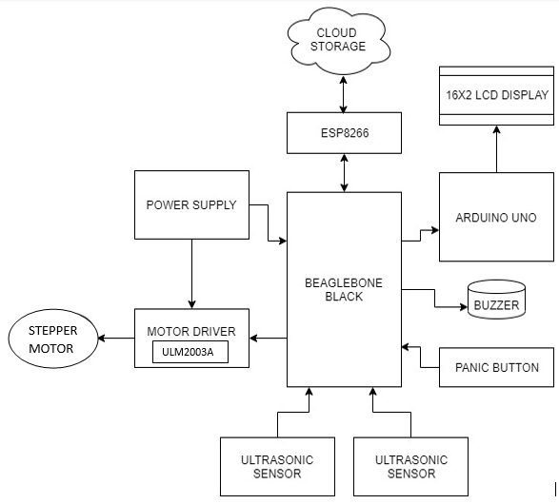
IOT BASED AUTOMATIC RAILWAY GATE CONTROLLER

Slide 3
LIST OF HARDWARE COMPONENTS TO BE TESTED
BeagleBone Black
Wi-Fi Module- ESP8266
Power Supply Module
Arduino Uno
LCD (16x2)
Ultrasonic sensors
Buzzer
Panic Button
Motor Driver
Stepper Motor
Train

Slide 4
TESTING OF HARDWARE COMPONENTS
Testing of Hardware Components include
Testing hardware under conditions simulating expected real-life conditions, including storage, transportation, operation and maintenance environments
Ensuring the hardware confirms with local environmental requirements, including shelter, space, furnishings and fittings, electrical power supply and relevant extremes of temperature, humidity and pollution
Verifying that hardware can perform under expected normal conditions and possible abnormal conditions
Ensuring appropriate security measures are in place and that they confirm to appropriate standards.

Slide 5
TESTING OF HARDWARE COMPONENTS
Testing measures include
The functionality of all the component should be working fine.
Conducting 'load tests', simulating as closely as possible a variety of 'real life' conditions and using or exceeding the amounts of data that could be expected in an actual situation.
Applying 'non-operating' tests to ensure that equipment can stand up to expected levels of physical handling, such as transit drop tests
There should not presence of any Critical or High or Medium severity & priority defects

Slide 6
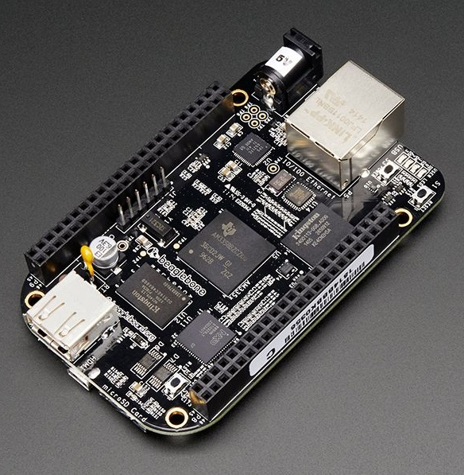
Beaglebone Black
Hardware Specification:
Power 5V, 3.3V
3.3V I/O on all signals
McASP0, SPI1, I2C, GPIO(65), LCD, MMC1, MMC2, 7 AIN(1.8V MAX), 4 Timers, 3 Serial Ports, CAN0, EHRPWM(0,2), XDMA Interrupt, Power button, Expansion Board ID (Up to 4 can be stacked)

Slide 7
Beaglebone Black- Testing Steps
Testing of beaglebone black Rev C
Beaglebone black will be the central component, it will communicate with all the other peripherals and maintain the sync between them.
We will be using the embedded Linux OS on Beaglebone black to create a muti-threaded application
For testing beaglebone, following should be tested
Linux installation
Create a SSH session from Host machine with Beagle bone
Create a C based code
Execute the code

Slide 8
Steps to load and run application in the BeagleBone black:
Write and debug the code on the desktop/host machine using the Eclipse IDE.
Connect the BeagleBone with the host system (computer/laptop) using USB cable.
Login into BeagleBone using the command: ssh 192.168.7.2 – l debian
It will ask for password then enter “temppwd”.
Make the source code into a compressed file using tar or gzip.
Using sftp protocol type the command: sftp debian@192.168.7.2 and send the source code into the beaglebone using the put command: sftp > put filename
Uncompress the file received in beaglebone
Compile the source code sent into beaglebone using GCC
Finally run the source code in beaglebone

Slide 9
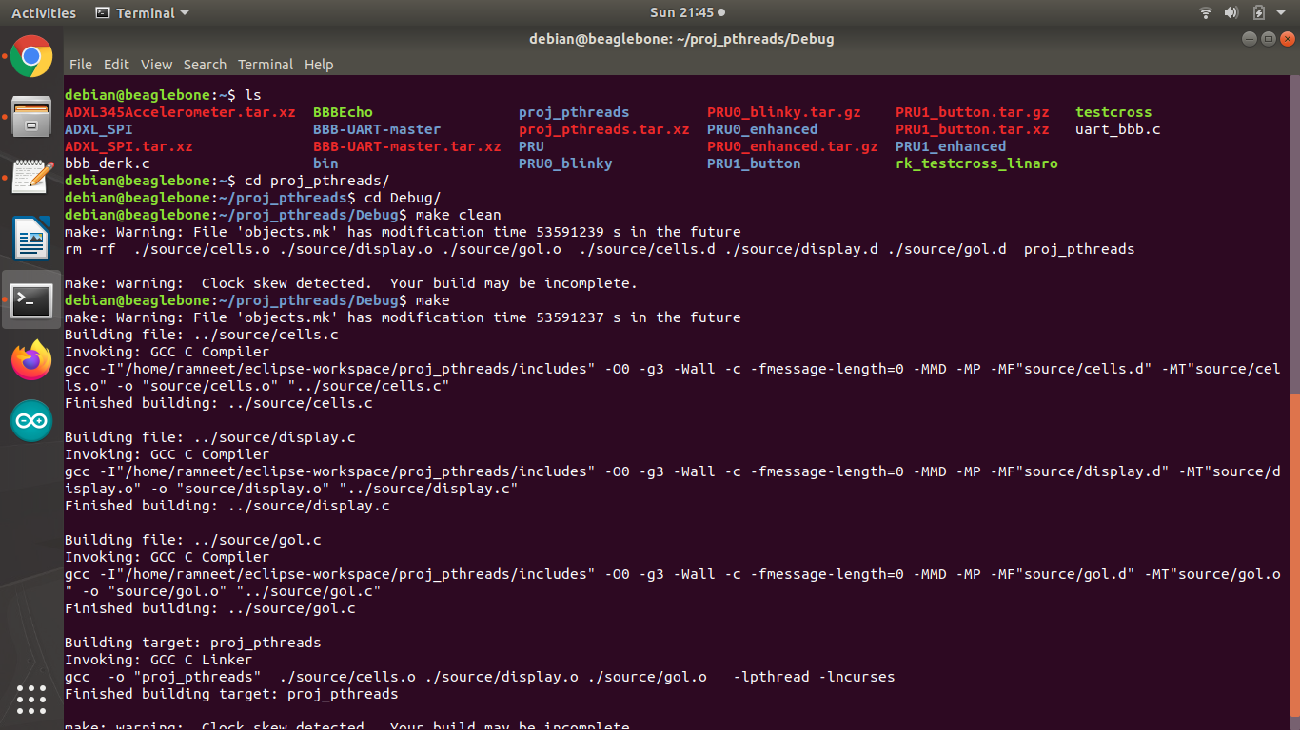
Code used for testing-

Slide 10
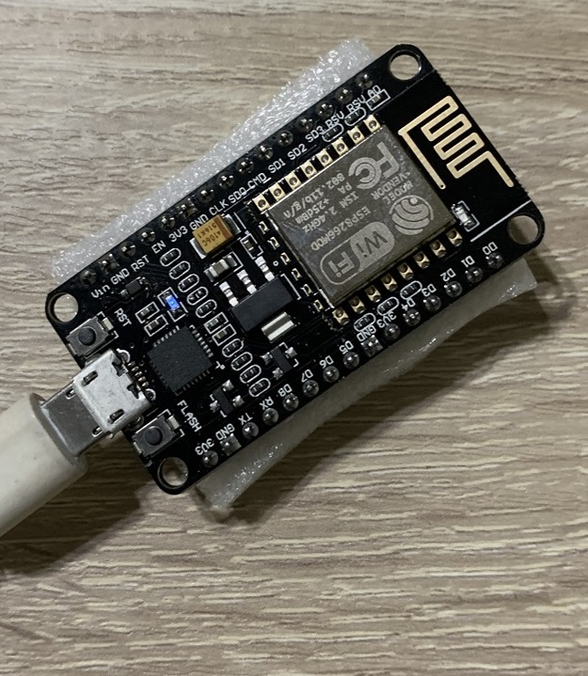
ESP8266
Hardware Specification:
Operating Voltage: 3.3V
Input Voltage: 7-12V
ADC input voltage 0-3.3V
80mA Operating Current
20 µA during Sleep Mode

Slide 11
ESP8266 - Testing Steps
Testing of ESP8266
In this project on board WiFi functionality of ESP8266 is used to connect with internet
Additionally we will use it to connect to MQTT broker and publish and subscribe messages
We will use the UART pins on the ESP to connect to Beaglebone black
To test ESP, following should be tested
WiFi functionality
Support for HTTP protocol

Slide 12
Steps to load and run application in the ESP8266:
To test ESP, Arduino IDE will be used to generate the code and flash the code in ESP module
Open Arduino IDE and from the Tools Button, Select the board as ESP8266
Now from the File menu, select the Examples Option
There are multiple examples for ESP8266 board, we can use any one for testing purpose, but as we need to check the WIFI connectivity of the board, we select the HTTP server example
In this example, ESP will behave as a server and open a small webpage when we connect from any other device using the IP address of the ESP
In the code, change the SSID and Password to the credentials matching the local network.
Connect the ESP8266 board to host computer
Now select the COM port on which the ESP is connected, to do so open Tools menu and Select the COM port from the available list

Slide 13
Steps to load and run application in the ESP8266 cont…
To compile and flash the code in ESP module select the Arrow option in the tool bar, it will start uploading the code
In the console window at the bottom of the screen, the status of code compilation and flashing is displayed
Once the code compilation is complete, open the Serial Monitor in the Arduino IDE, the status of Wifi connection will be printed in the console
Once the Wifi is connected, in the web browser of the system, open the IP address of the ESP
If all goes well it should have the string printed “Hello, from ESP”

Slide 14
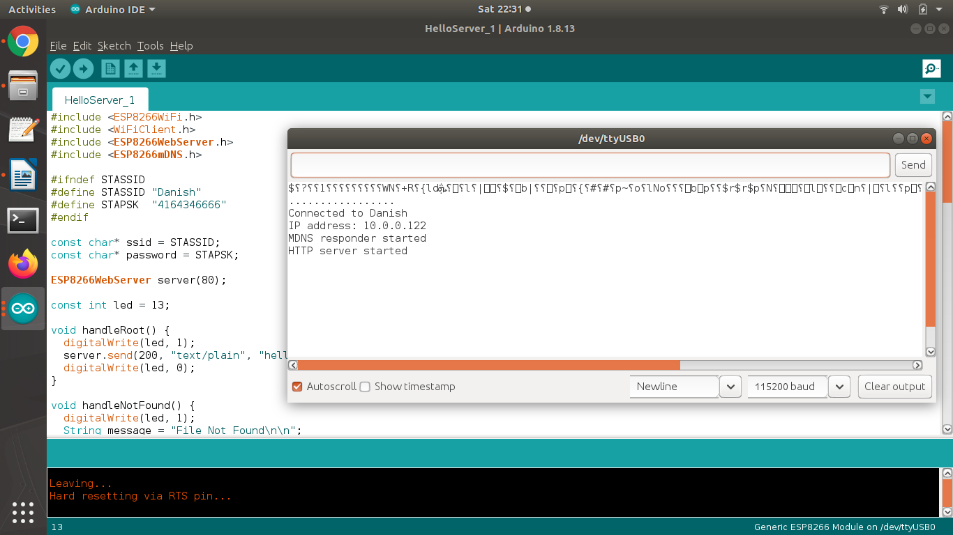
Code Used for Testing-

Slide 15
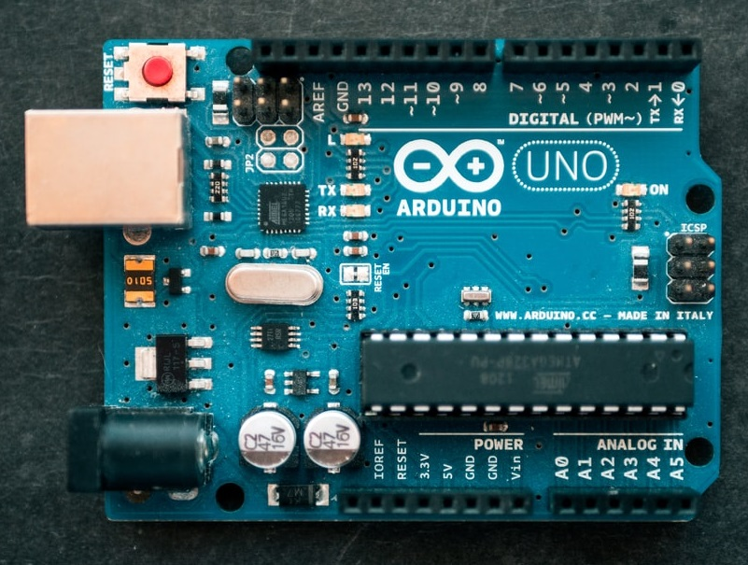
Arduino UNO
Hardware Specification:
Operating Voltage: 5 Volts
Input Voltage: 7 to 20
DC Current per I/O Pin: 20 mA
DC Current for 3.3V Pin: 50 mA

Slide 16
Features:
It is an open source software that is mainly used for writing and compiling the code into the Arduino Module.
Arduino boards can read analog or digital input signals from different sensors and turn it into an output such as activating a motor, turning LED on/off, connect to the cloud and many other actions.
We can control our board functions by sending a set of instructions to the microcontroller on the board via Arduino IDE.
The Arduino IDE uses a simplified version of C or C++, making it easier to learn to program. It consists of void setup() and void loop() part
In void setup() code will only run once and that will be at the beginning of our program.
In void loop() code will repeat repeatedly.
The main code, also known as a sketch, created on the IDE platform will ultimately generate a Hex File which is then transferred and uploaded in the controller on the board.

Slide 17
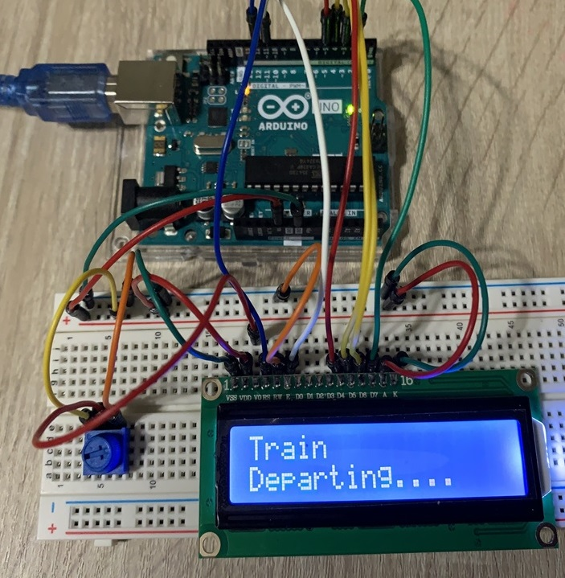
16x2 LCD
Hardware Specification:
Operating Voltage is 4.7V to 5.3V
Current is 1mA with no backlight
Variable voltage pin for modifying contrast+

Slide 18
LCD 16*2 - Testing Steps
Testing of LCD 16*2
In this project LCD is used to display the status of train Arrival or departure at the railway crossing
LCD is connected to Arduino UNO board using parallel interface
Arduino will receive message from Beaglebone black that is to be displayed on LCD
To test LCD, following should be tested
Display a string on both the rows of LCD
Update and change the String

Slide 19
Steps to test 16*2 LCD:
To test the LCD, we will connect the LCD to Arduino Uno and use the Arduino to update the data on LCD screen
Open Arduino IDE and from the Tools Button, Select the board as Ardino Uno
Now from the File menu, select the Examples Option
From the displayed list select the liquid crystal example
Connect the LCD to the Arduino Board using the following connection information
LCD RS pin to digital pin 12
LCD Enable pin to digital pin 11
LCD D4 pin to digital pin 5
LCD D5 pin to digital pin 4
LCD D6 pin to digital pin 3

Slide 20
LCD D7 pin to digital pin 2
LCD R/W pin to GND
LCD VSS pin to GND
LCD VCC pin to 5V
LCD LED+ to 5V through a 220 ohm resistor
LCD LED- to GND
Connect the Arduino board to host computer
Now select the COM port on which the Arduino Uno is connected, to do so open Tools menu and Select the COM port from the available list
To compile and flash the code select the Arrow option in the tool bar, it will start uploading the code
Once uploaded The LCD should display the expected string

Slide 21
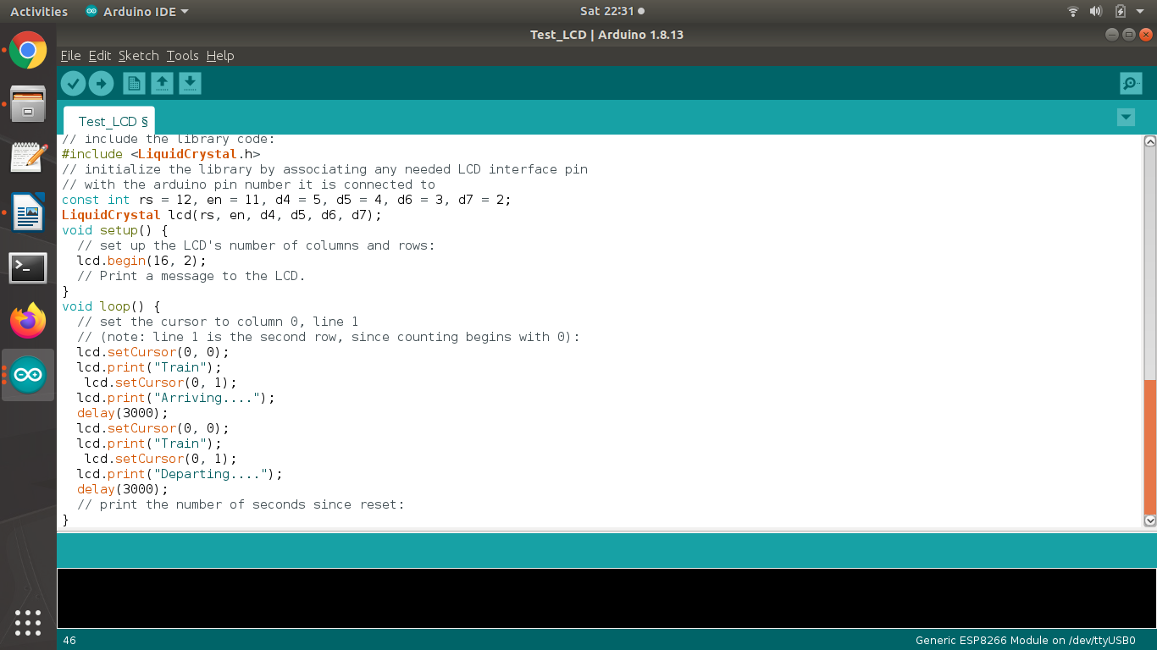
Code Used for Testing

Slide 22
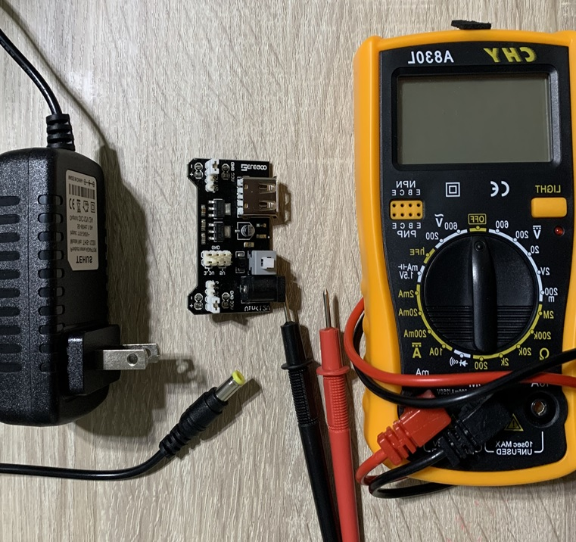
Power Supply
Hardware Components and Specifications:
Power Adapter -
Output Voltage 12 V
Input Voltage : 120 V
Breadboard breakout supply -
Input Supply : 12V
Output Voltage : 5V and 3.3V

Slide 23
Power Supply - Testing Steps
Testing of Power supply
To test the power supply, we need to check the voltage output from both the components
To check the voltage we need to use the Multimeter
Power Adapter
Plug the power supply to the wall socket
Set the multimeter to DC voltage - 20 V
Connect the Red Wire from the multimeter to the outer or shiny portion of the output pin from Adapter and the black wire to inner section of the power supply
The multimeter should show 12V as output

Slide 24
Testing of Power supply Cont…
Breadboard breakout supply
Connect the power adapter to breakout board
Set the multimeter to DC voltage - 20 V
The pins on breakout board are marked with 3.3V and 5V
Connect the Red wire from multimeter to +5V pin on the board and black wire to GND pin
Multimeter output should show 5V
Connect the Red wire from multimeter to +3.3 V pin on the board and black wire to GND pin
Multimeter output should show 3.3V

Slide 25
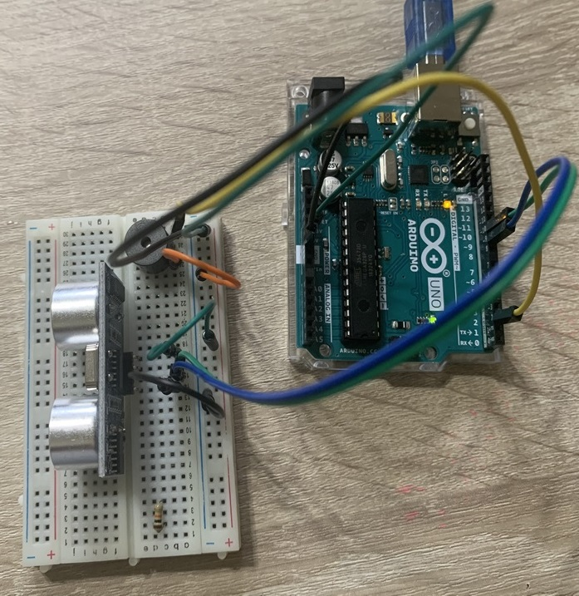
Ultrasonic Sensor & Buzzer
Hardware Specification:
Ultrasonic Sensor (HC SR04):
Operating Voltage: DC 5V
Operating Current: 15mA
Max Range: 4m
Min Range: 2cm
Buzzer :
Operating Voltage : 4-8V
Max Current : <=32mA

Slide 26
Ultrasonic sensor and Buzzer- Testing Steps
Ultrasonic Sensor-
In this project two Ultrasonic sensors are used to sense the Arrival and departure of the train at the railway crossing.
These are connected to Beaglebone black.
Buzzer-
Buzzer is used for two purposes:
1. Signal the arrival and departure of train
2. Alert in Emergency situation

Slide 27
Steps to test Ultrasonic sensor and Buzzer-
Connections of Ultrasonic Sensor with Arduino Uno for testing:
Sensor has 4 wires Vcc, Trigger, Echo and Ground
Vcc and Ground wires are connected to 5V and GND with Arduino uno
Trigger is connected to pin 10 of Arduino Uno
Echo is connected to pin 9 of Arduino Uno
Connections of Buzzer with Arduino Uno for testing:
Buzzer has 2 wires i.e positive and negative.
Positive is connected to pin 2 from Arduino.
Negative is connected to ground n breadboard

Slide 28
Steps to test Ultrasonic sensor and Buzzer-
Connect the Arduino board to host computer
Now select the COM port on which the Arduino Uno is connected, to do so open Tools menu and Select the COM port from the available list.
We have taken a demo code from https://create.arduino.cc/projecthub/ammaratef45/detecting-obstacles-and-warning-arduino-and-ultrasonic-13e5ea
In this code, when Sensor will something in the range a buzzer will beep.
To compile and flash the code select the Arrow option in the tool bar, it will start uploading the code to Arduino Uno

Slide 29
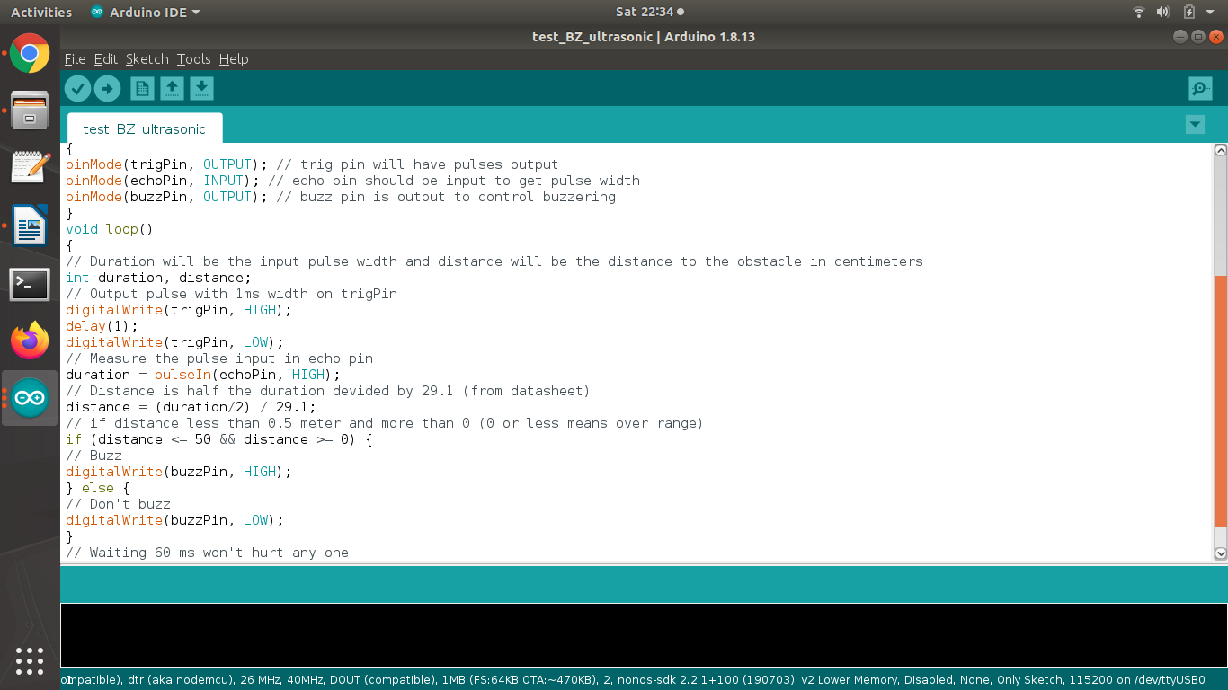
Code Used for Testing-

Slide 30
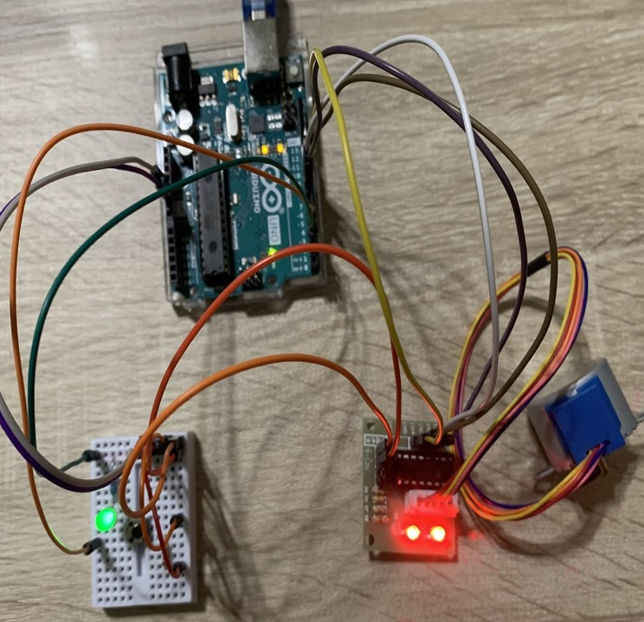
Motor and Switch
28BYJ-48 Stepper motor and
the ULN2003 Driver module-
Rated Voltage: 5V
Stride Angle: 5.625°/64
Switch
A push button switch with 4 pin is used

Slide 31
Stepper Motor and Switch- Testing Steps
We have used the 28BYJ-48 Stepper motor and the ULN2003 Driver module that will change the state of Gate as OPEN and CLOSE.
This is connected to beaglebone black directly on GPIO pins.
Stepper motors will operate only with the help of a driver module. This is because the controller module (In our project its BBB and for testing its Arduino Uno) will not be able to provide enough current from its I/O pins for the motor to operate. So we will use an external module like ULN2003 module as stepper motor driver
For testing switch, we have used a LED along with stepper motor.
If the state of switch is HIGH then LED will be on else if the state of switch is LOW then motor will rotate.

Slide 32
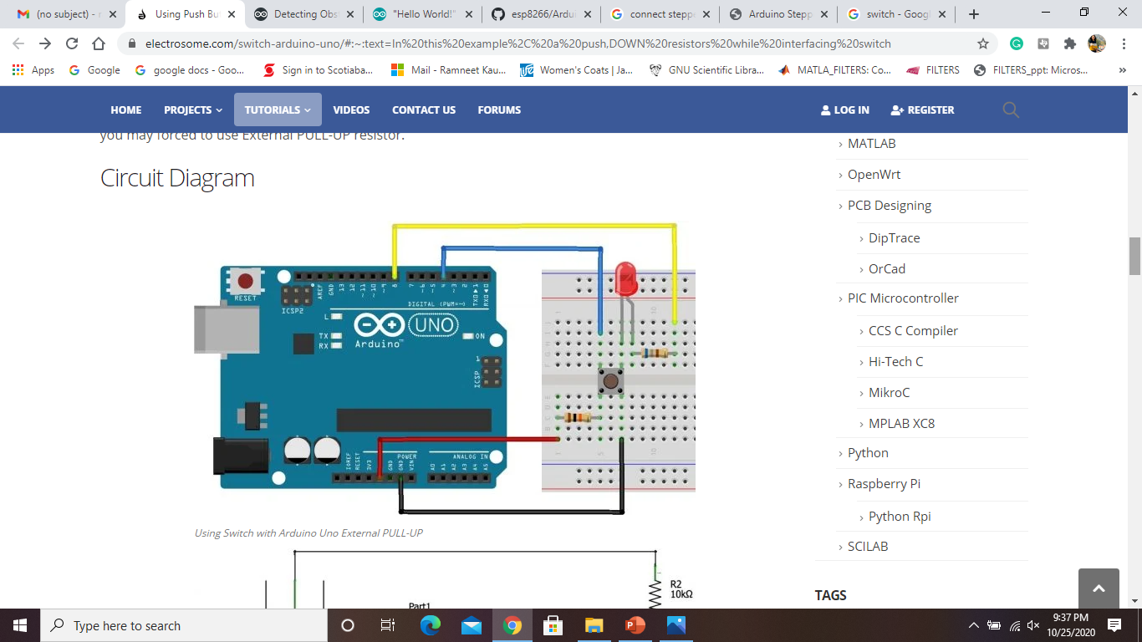
Stepper Motor and Switch Connections-
Connections of Motor with Arduino Uno for testing:
Motor is connected to driver circuit with a 5-pin connector that is ready to use type.
Driver circuit is connected to Arduino Uno using 6 pins, out of which 2 are Vcc and ground. These two are connected to Arduino 5V and Ground respectively.
Rest 4 pins of Driver circuit are input from Arduino and are connected to 8,9,10,11 pins of Arduino Uno.
Connections of Switchwith Arduino Uno for testing:
the switch is connected to digital pin 4 (D4)
LED is connected to digital pin 8 (D8) of Arduino Uno.
Schematic diagram shows the connections of switch and LED with Arduino Uno.

Slide 33
Stepper Motor and Switch Testing Steps
Connect the Arduino board to host computer
Now select the COM port on which the Arduino Uno is connected, to do so open Tools menu and Select the COM port from the available list.
In the code, If the state of switch is HIGH then LED will be on else if the state of switch is LOW then motor will rotate .
To compile and flash the code select the Arrow option in the tool bar, it will start uploading the code to Arduino Uno

Slide 34
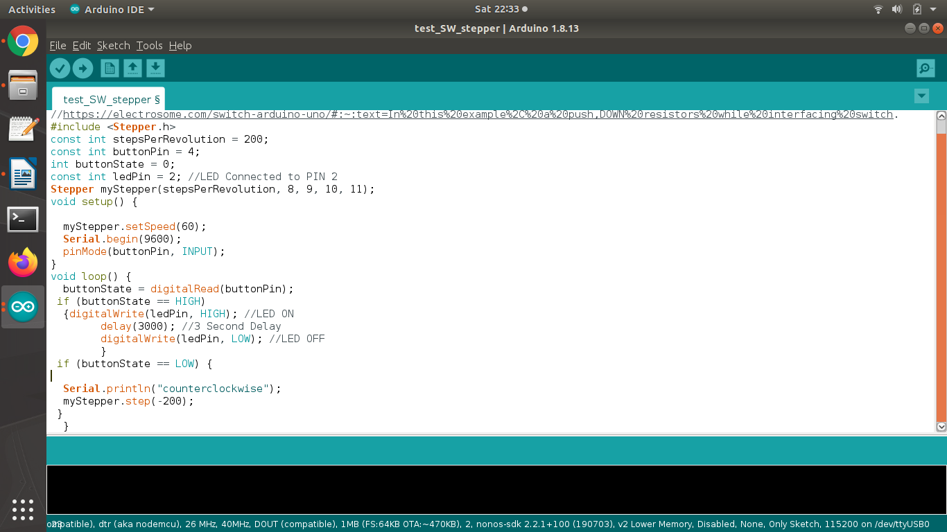
Code Used for Testing-

Slide 35
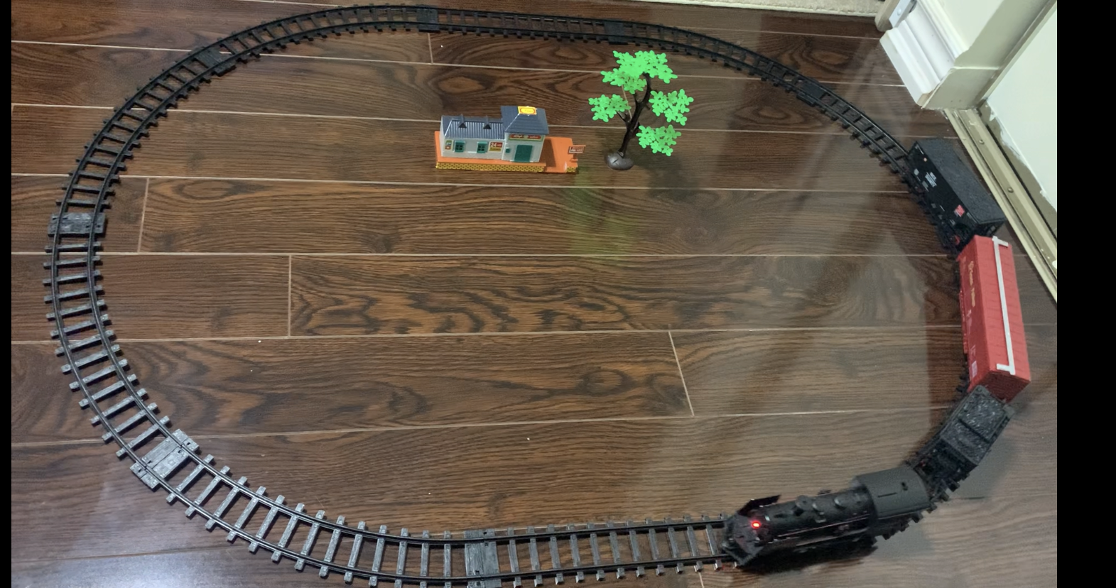




The Train

Slide 36
References:
Ali, A. A. (2016, Feburary 12). Project Hub. Retrieved from Create.Arduino: https://create.arduino.cc/projecthub/ammaratef45/detecting-obstacles-and-warning-arduino-and-ultrasonic-13e5ea
earlephilhower. (NA). esp8266/Arduino. Retrieved from Github.com: https://github.com/esp8266/Arduino
Raj, A. (2017, August 15). Interfacing Stepper Motor with Arduino Uno. Retrieved from Circuit Digest: https://circuitdigest.com/microcontroller-projects/arduino-stepper-motor-control-tutorial
Tomy, A. (NA, July). Using Push Button Switch with Arduino Uno. Retrieved from Electro Some: https://electrosome.com/switch-arduino-uno/#:~:text=In%20this%20example%2C%20a%20push,DOWN%20resistors%20while%20interfacing%20switch

Slide 37
THANK YOU!!

